Slide 1
CSE7000 - INTERNSHIP A Presentation on AI-POWERED STUDENT ASSISTANT LEARNING
Student Details
Name | SNEHA S
Roll No | 20241CSE0846
Section | 5CSE12
Under the Supervision of,
Mr. Sakthi S
Assistant Professor
Presidency School of Computer Science and Engineering
Presidency University
Name of the Program: Computer Science and Engineering
Name of the HOD: Dr. Asif Mohamed H.B
Name of the Program Internship Coordinator: Dr .R . Balakrishnan
Name of the School Internship Coordinators : Dr Bhuvaneshwari Patil

Slide 2
Content
About Company or Organization
Working domain or the Technology
Objectives of the work
Methodology Used / Course Description
Results (Optional)
Conclusion

Slide 3
About Company or Organization
NVIDIA Corporation is a global technology company founded in 1993 and headquartered in Santa Clara, California, USA. It is a pioneer in Graphics Processing Units (GPUs), Artificial Intelligence (AI), accelerated computing, and high-performance computing (HPC), delivering innovative solutions that power modern computing across industries
During my internship at NVIDIA GPU, I gained practical knowledge of Artificial Intelligence (AI), Machine Learning (ML), Deep Learning, and GPU computing. I learned the fundamentals of Python programming, and GPU acceleration techniques for improving computational performance. I also developed an understanding of data preprocessing, model training, and performance evaluation using AI frameworks. Additionally, I enhanced my problem-solving, analytical thinking, teamwork, and technical communication skills by working on hands-on projects, assignments, and collaborative learning activities.
Key Products : Python , NumPy & Pandas , Matplotlib & Seaborn , Scikit-learn, Pytorch , TensorFlow , Jupyter Notebook , NVIDIA GPU Architecture , High-Performance Computing (HPC).
Major Clients : Microsoft Azure ,Amazon Web Services (AWS),Google Cloud ,OpenAI ,Meta ,Tesla , Dell Technologies ,Lenovo ,Cisco ,Samsung ,BMW Group ,Mercedes-Benz.

Slide 4
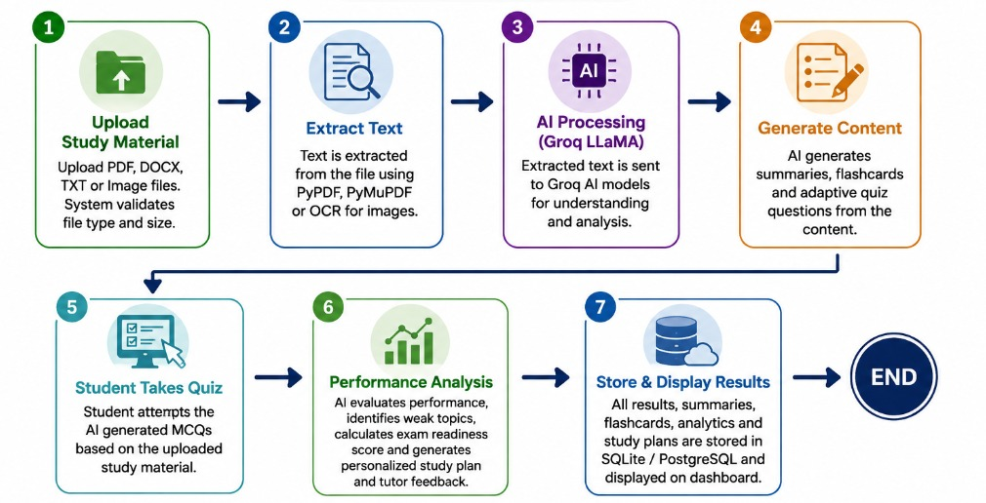
Working domain
Assigned domain : AI-Powered Student Assistant Learning
Key features :
1.PDF-Based Learning
Upload study materials in PDF format.
2. AI Content Extraction
Automatically extracts and understands text from uploaded documents.
3. Automatic Flashcard Creation
Generates topic-wise flashcards for quick revision and improved memory retention.
4. AI-Generated Quizzes
Creates multiple-choice quizzes automatically from the uploaded study material.
5. Instant Feedback & Correct Answers
Provides immediate quiz results and displays the correct answer with an explanation for incorrect responses.
6. Performance Tracking
Monitors quiz scores, learning progress, and completed topics.
7. Leaderboard
Displays student rankings based on quiz performance to encourage healthy competition.

Slide 5
Objectives of the work
Purpose of the work:
1.Automate Learning from PDF Documents
Develop an AI-powered system that extracts content from uploaded PDF study materials and automatically generates key points, flashcards, and quizzes.
2. Enhance Student Learning Experience
Provide personalized and interactive learning through AI-generated summaries, revision flashcards, instant quiz feedback, and correct answer explanations.
3. Improve Student Performance
Monitor learning progress using quizzes and leaderboards, helping students identify knowledge gaps and strengthen their understanding through continuous assessment.

Slide 6
Usage of work:
1.Smart Learning and Revision
Enables students to upload PDF study materials and automatically generate key points, flashcards, and quizzes for efficient learning and quick revision.
2. Self-Assessment and Knowledge Improvement
Helps students evaluate their understanding through AI-generated quizzes, providing instant feedback, correct answers, and explanations to strengthen conceptual knowledge.
3. Performance Monitoring and Engagement
Tracks learning progress using quiz scores and leaderboards, encouraging continuous learning, healthy competition, and improved academic performance.

Slide 7
Methodology Used / Course Description
Methodology Study Material Upload PDF, DOCX, TXT, or Image files.
Content Extraction Extract text using Py PDF, Py Mu PDF, or OCR.
AI Processing Send extracted text to Groq LLMA models.
Generate summaries, flashcards, and quizzes.
Student Assessment Student attempts AI-generated MCQs
System evaluates responses automatically.
Performance Analysis Identify weak topics.
Calculate exam readiness score.
Generate personalized study plans and AI tutor feedback.
Data Storage Store summaries, quiz results, and analytics in SQLite/PostgreSQL.
Display results through the student dashboard.

Slide 8
Methodology Used / Course Description
Methodology – Core Modules
File Processing
• Supports PDF, DOCX, TXT, MD, PNG, and JPG file formats.
AI Content Generation
• Processes extracted content using Groq LLMA models.
• Generates summaries, flashcards, revision notes, and quizzes.
Quiz & Assessment
• Creates adaptive MCQs based on uploaded study materials.
• Evaluates student responses and calculates quiz scores.
Performance Analysis
• Identifies weak topics and exam readiness.
• Generates personalized study plans and AI tutor feedback.
Data Management
• Stores study materials, quiz history, analytics, and user progress.
• Displays results through an interactive dashboard.

Slide 9
Results
1.Improved Learning Efficiency
Reduced the time required for studying by automatically generating concise summaries, flashcards, and quizzes from uploaded PDF documents.
2.Instant Error Correction
Helped students learn from mistakes by displaying the correct answer and a brief explanation immediately after an incorrect response.
3.Simplified Study Process
Transformed lengthy PDF documents into structured learning resources, making revision faster and more effective.
4.Enhanced Academic Performance
Encouraged continuous self-assessment, resulting in better understanding, improved confidence, and higher learning outcomes.
5. Efficient AI-Based Automation
Successfully automated content extraction, summarization, quiz generation, and performance evaluation, minimizing manual effort.

Slide 10
Conclusion
Successfully developed an AI-powered Student Assistant Learning Platform to enhance the learning experience.
Simplifies studying by generating flashcards, quizzes, key points, and summaries from uploaded PDFs.
Provides instant feedback and correct answers to improve understanding and knowledge retention.
Encourages continuous learning through leaderboards and interactive assessments.
Demonstrates the effective use of Artificial Intelligence in making education more personalized, engaging, and efficient.
GitHub Profile : https://github.com/SnehaS1212
Repository : https://github.com/SnehaS1212/ai-student-learning-assistant

Slide 11
Q&A

Slide 12
Thank you !!

